Slide 1

Vishwakarma Government College
Chandkheda, Ahmedabad
Electronics and Communication Department
8th Semester Project Presentation

Slide 2

Project Presentation
on
VEHICLE IDENTIFICATION AND COUNTING FOR TRAFFIC SURVEILLANCE
Prepared By:
Patel Milan A. (090170111064)
Prajapati Snehal M. (090170111067)
Pathak Rutvik M. (090170111011)
Group No. : 37
Guided By:
Prof. Kinjal Vagadia

Slide 3
Why we choose this project?
In recent years, as a result of the increase in vehicle traffic, many problems have appeared. For example, traffic accidents, traffic congestion and so on. Traffic congestion has been a significantly challenging problem. It has widely been realized that increases of preliminary transportation infrastructure e.g., more pavements, and widened road, have not been able to relieve city congestion.
As a result, many investigators have paid their attentions on intelligent transportation system (ITS), such as predict the traffic flow on the basis of monitoring the activities at traffic intersections for detecting congestions.
Automatic detecting vehicles in video surveillance data is a very challenging problem in computer vision with important practical applications, such as traffic analysis and security.

Slide 4
Aims of our project
To take a video and to identify and count the number of vehicles passing on a road.
To study about background elimination, frame difference, object identification, background registration, vehicle counting.

Slide 5
Presentation Outline
Traffic Surveillance System
Block Diagram
Background Registration
Foreground Detection
Image Segmentation
Vehicle Counting
Applications
Results

Slide 6
Traffic Surveillance System
Detecting and tracking vehicles in video surveillance data is a very challenging problem in computer vision with important practical applications, such as traffic monitoring and analysis, congestion, accidents.
A system has been developed to detect and count objects efficiently.
Video surveillance for road vehicles is a key component for smooth and secure transportation systems.

Slide 7
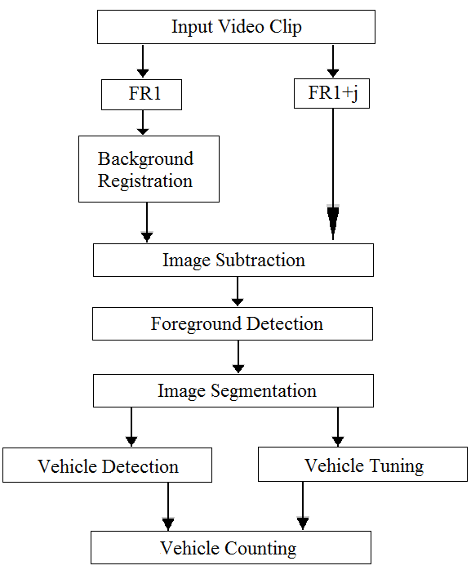
Block Diagram

Slide 8
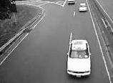
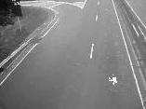
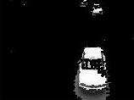
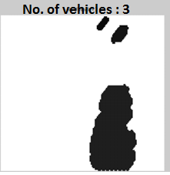
Sample Illustration of operations
(a) Original Image
(b) Background Registered
(c) Foreground Detection
(d) Object Tracked

Slide 9
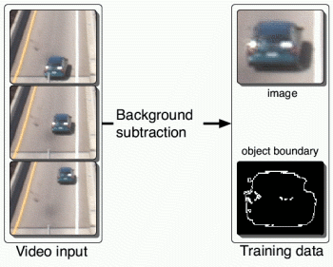
Background Registration
A general detecting approach is to extract salient regions from the given video clip using a learned background modeling technique.
This involves subtracting every image from the background scene .
Here first frame is assumed
as initial background and
thresholding the resultant
difference image to determine
the foreground image.

Slide 10
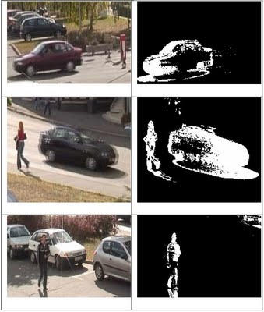
Foreground Detection
Detecting information can be used to refine the vehicle type.
After registering the static objects
the background image is
subtracted from the video frames
to obtain the foreground dynamic
objects.

Slide 11
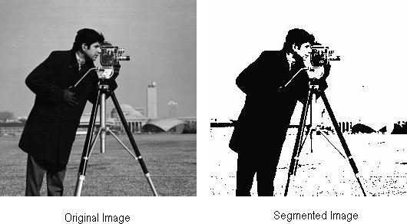
Image Segmentation
In general, two steps are used in this study:
Segmentation to object regions of interest
In this step, regions
which may contain
unknown objects have
to be detected.
Focus on the extraction
of suitable features
and then extraction
of objects.

Slide 12
Vehicle Counting
The tracked image forms the input image for counting. This image is scanned from top to bottom for detecting the presence of an object.
A variable named, count that keeps track of the number of vehicles is used for counting .
This concept is applied for the entire image and the final count of objects is present in variable count.
A fairly good accuracy of count is achieved by setting the value of number of frames.

Slide 13
Applications
Identification and counting of vehicles help us to avoid traffic congestion beforehand at cross roads.
Counting helps us to decide signaling at particular areas where traffic is to be diverted to avoid complexity.
It helps us in power savings of signs, boards and hoardings on highways, based on the number of vehicles.
Diverting the traffic for smooth flow of traffic.
Eliminating the use of manpower for surveying and replace it with the use of current technology.

Slide 14
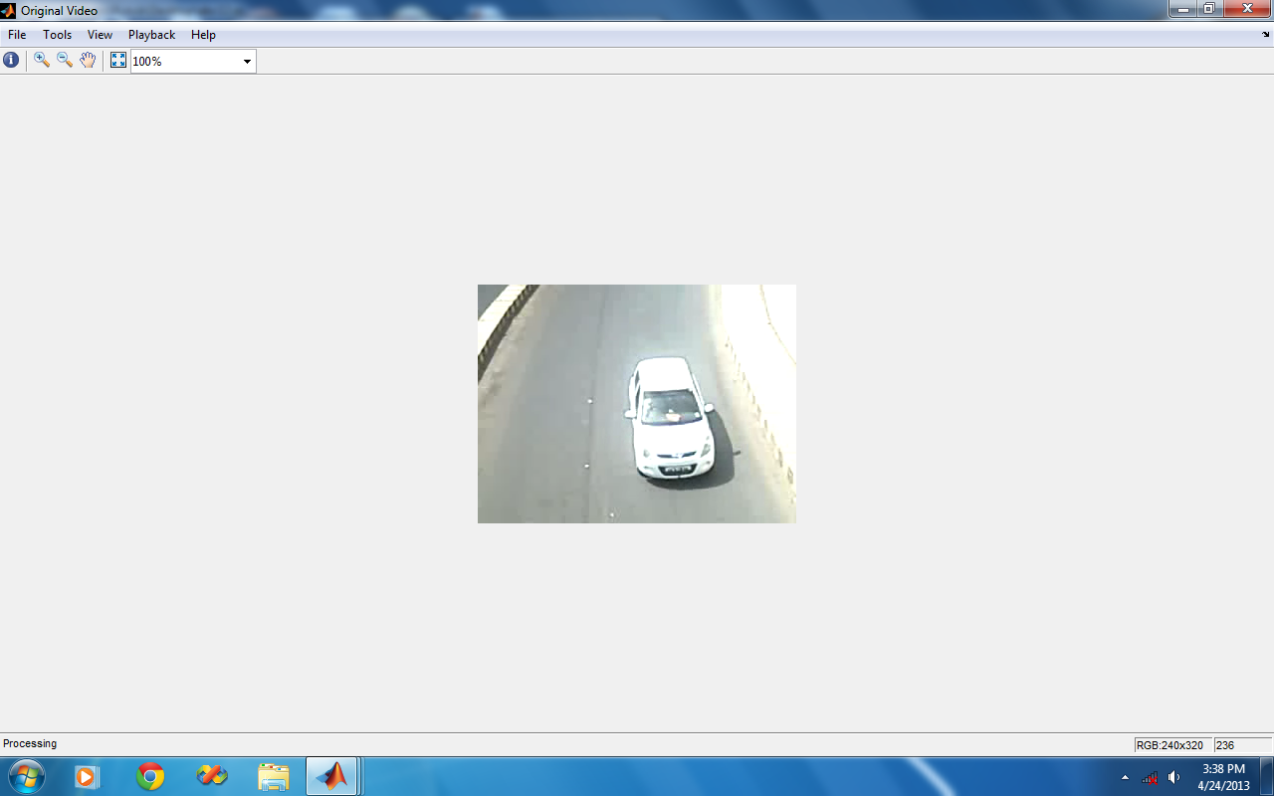
Input Video

Slide 15
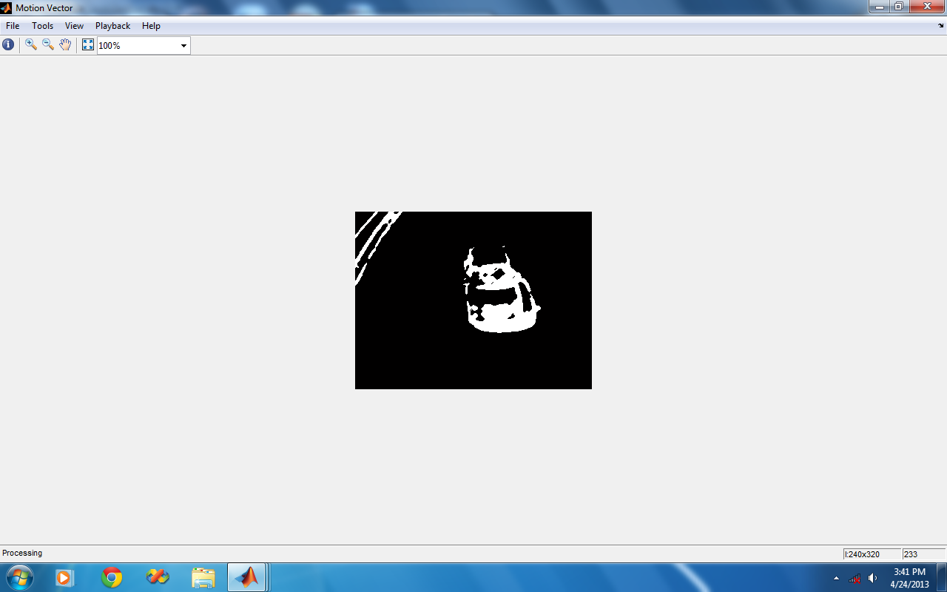
Foreground Detection

Slide 16
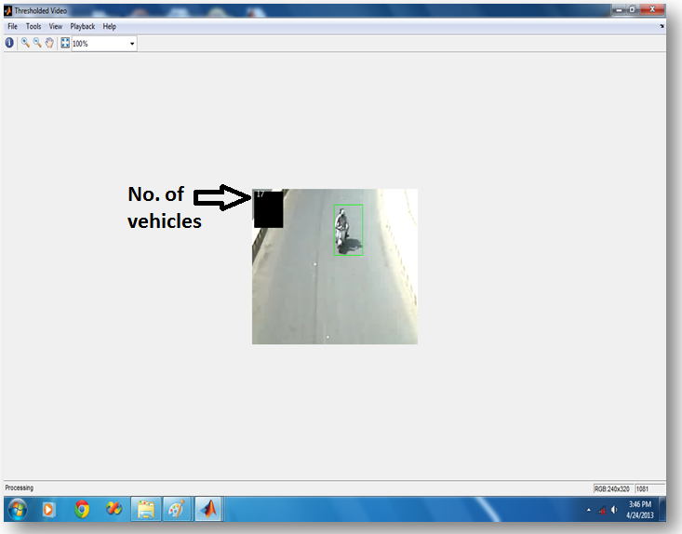
Detection and Counting

Slide 17
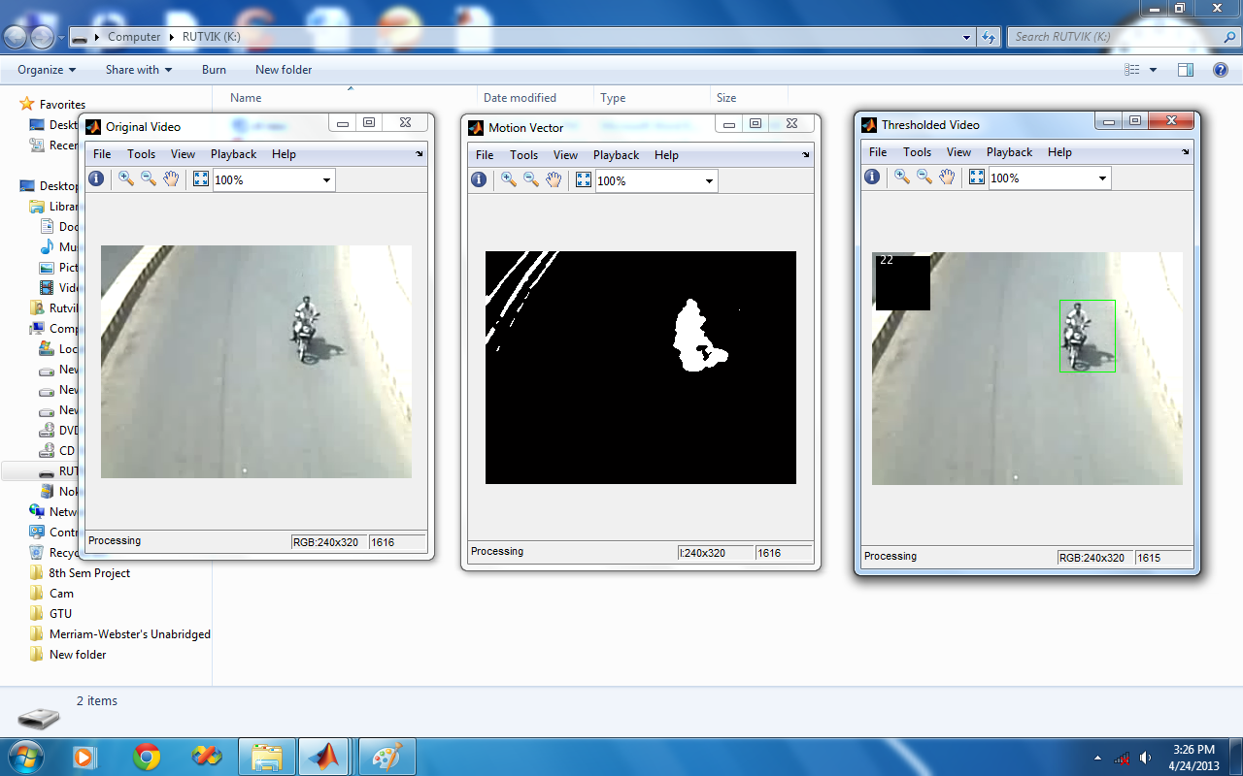
Combined Results

Slide 18
Future scope of expansion
Currently the application is working in a standalone system, if we implement this application to multiple locations in the town using web application then the data can be further used for traffic controlling and planning.
This project, that counts number of vehicles can also be expanded to classify the vehicles for better estimate of traffic flow.
The system can be implemented on roads, highways, having mounted camera, capturing videos and control room continuously getting vehicle counts, so necessary measures can be taken sitting at control room itself.

Slide 19
Thank You…
Prepared By: Patel Milan A.
Prajapati Snehal M.
Pathak Rutvik M.
( Group No. : 37 )

